Slide 1

Introduction to Windows Azure Data Services October 2013

Slide 2


Table of Contents
Windows Azure Data Management
Table Storage
Blob Storage
Queues
Best Practices
Azure Tables
Azure Blobs
Azure Queues

Slide 3
Windows Azure Data Management
Azure Tables
Azure Blobs
Azure Queues
Notes:
Slide Objectives:
Highlight the four areas in which this session will focus on.
VALUE PROP:
Speaking Points:
This session will cover the following topics:
SQL Server in a Virtual Machine
Windows Azure SQL Database
Azure Table Storage
Azure Blob Storage
Notes:

Slide 4
Windows Azure Table Storage
NoSQL Data Storage
Fully managed PaaS
Key-value
Hierarchical
REST API
Geo replication
Account
Storage Account: MovieData
Table Name: Movies
Star Wars
Matrix
Fan Boys
Table
Entity
Notes:
Slide Objectives:
Define the table storage and differentiate it from a Windows Azure SQL Database
VALUE PROP
Highly scalable NoSQL Data storage
Speaking Points:
Tables offer NoSQL capabilities for applications that require storage of large amounts of unstructured data. Tables are an ISO 27001 certified managed service which can auto scale to meet massive volume of up to 100 terabytes and throughput and accessible from virtually anywhere via REST and managed API’s.
Tables store entities
Entity schema can vary in the same table
Hierarchial
Automatic scalability
New Geo Replication
Notes:

Slide 5
Table Storage Concepts
Account
Table
Entity
Name =…
Email = …
customers
Name =…
EMailAdd=
contoso
Photo ID =…
Date =…
photos
Photo ID =…
Date =…
Notes:
Slide Objectives
Understand Tables
VALUE PROP
Enable customers to easily migrate, maintain, and monitor their existing SQL Server applications to Windows Azure VM role, and run them with competitive reliability, performance, and TCO characteristics.
Speaker Notes
The Table service provides structured storage in the form of tables.
The Table service supports a REST API that is compliant with the ADO.NET Data Services REST API.
Developers may also use the .NET Client Library for ADO.NET Data Services to access the Table service.
Notes
Within a storage account, a developer may create named tables. Tables store data as entities. An entity is a collection of named properties and their values, similar to a row. Tables are partitioned to support load balancing across storage nodes. Each table has as its first property a partition key that specifies the partition an entity belongs to. The second property is a row key that identifies an entity within a given partition. The combination of the partition key and the row key forms a primary key that identifies each entity uniquely within the table.

Slide 6
No Fixed Schema
 | FIRST | LAST | BIRTHDATE
 | John | Doe | 3/27/1986
 | Jane | Smith | 2/2/1976
 | Frank | Jones | June 2, 1979
FAV SPORT
Canoeing
Notes:
Slide Objectives
Understand Flexible Entities
VALUE PROP
Enable customers to easily migrate, maintain, and monitor their existing SQL Server applications to Windows Azure VM role, and run them with competitive reliability, performance, and TCO characteristics.
Speaker Notes
Tables store data as entities.
A table can contain entities of any shape
There is no fixed schema
There is no schema checking
There is no strong typing- not that Birthdate is stored as both a datetime value and as a string
Not that we can add additional columns
Notes
http://msdn.microsoft.com/en-us/library/dd573356.aspx

Slide 7
Scalability
PartitionKey
Unique identifier for the partition within a given table
RowKey
Unique Identifier for an entity within a given partition
Both keys matter!
Define Primary Key
Forms a single clustered index
Very Fast
Partition Key + Row Key
Slower
Only Partition Key
No Row Key
Slowest
No Partition Key
No Row Key
Notes:
Slide Objectives
Understand the importance of Windows Azure Table scalability model and how Partition Key and Row Key are critical for table scalability
VALUE PROP
Enable customers to easily migrate, maintain, and monitor their existing SQL Server applications to Windows Azure VM role, and run them with competitive reliability, performance, and TCO characteristics.
Speaker Notes
Table entities represent the units of data stored in a table and are similar to rows in a typical relational database table. Each entity defines a collection of properties. Each property is key/value pair defined by its name, value, and the value's data type. Entities must define the following three system properties as part of the property collection:
PartitionKey – The PartitionKey property stores string values that identify the partition that an entity belongs to. This means that entities with the same PartitionKey values belong in the same partition. Partitions, as discussed later, are integral to the scalability of the table.
RowKey – The RowKey property stores string values that uniquely identify entities within each partition.
Notes
Tables are partitioned to support load balancing across storage nodes. A table's entities are organized by partition. A partition is a consecutive range of entities possessing the same partition key value. The partition key is a unique identifier for the partition within a given table, specified by the PartitionKey property. The partition key forms the first part of an entity's primary key. The partition key may be a string value up to 1 KB in size.

Slide 8
Purpose of the PartitionKey
Entity Locality
Entities in the same partition will be stored together
Efficient querying and cache locality
Try to include partition key in all queries
Entity Group Transactions
Atomic multiple Insert/Update/Delete in same partition in a single transaction
Table Scalability
Target throughput – 500 transactions/second per partition, several thousand tps/account
Windows Azure monitors the usage patterns of partitions
Automatically load balance partitions
Each partition can be served by a different storage node
Scale to meet the traffic needs of your table
Notes:
Slide Objectives
Understand The Partition Key
Speaker Notes
Tables are partitioned to support load balancing across storage nodes.
A table's entities are organized by partition.
A partition is a consecutive range of entities possessing the same partition key value.
The partition key is a unique identifier for the partition within a given table, specified by the PartitionKey property.
The partition key forms the first part of an entity's unique identifier within the table.
The partition key may be a string value up to 1 KB in size.
You must include the PartitionKey property in every insert, update, and delete operation.
Notes
http://msdn.microsoft.com/en-us/library/dd573356.aspx
http://blogs.msdn.com/b/windowsazurestorage/archive/2010/05/07/understanding-the-scalability-availability-durability-and-billing-of-windows-azure-storage.aspx
http://blogs.msdn.com/b/windowsazurestorage/archive/2010/05/10/windows-azure-storage-abstractions-and-their-scalability-targets.aspx

Slide 9
Scalability
Partition: Range of entities with same partition key value
Partitions are fanned out based on load
They can be condensed when load decreases
Reads are load balanced against three replicas
Server 1
Server 2
Server 3
P1
P2
Pn
Notes:
Slide Objectives
Understand the Windows Azure Storage scalability model
VALUE PROP
Windows Azure Storage scales automatically to provide the best performance
Speaker Notes
Fanout is automatic, handles by Windows Azure
The key here is “elasticity”. The ability to automatically scale based on load.
Fanout is based on the load. Fanout isn’t immediate…Windows Azure will wait several seconds to ensure that the load is a true load and not just a temporary spike
Partitioning is based on Partition Key – the choice of the partition key is critical
Partitions can be condensed when load increases
Reads are load balanced against the three replicas
Notes

Slide 10
Entity (The “Row”)
PartitionKey & RowKey*
Uniquely identifies an entity [PartitionKey + RowKey => Entity]
Row Key = Unique identifier within a partition
Defines the sort order
Timestamp*
Optimistic Concurrency
Exposed as an HTTP Etag
No fixed schema for other properties
Each property is stored as a <name, typed value> pair
No schema stored for a table
Standard .NET Types
String, binary, bool, DateTime, GUID, int, int64, and double
* Required
Notes:
Slide Objectives
Understand Tables and Entities
Speaker Notes
Tables store data as entities.
An entity is a collection of named properties and their values, similar to a row- not an RDBMS though
Tables are partitioned to support load balancing across storage nodes.
Each table has as its first property a partition key that specifies the partition an entity belongs to.
The second property is a row key that identifies an entity within a given partition.
The combination of the partition key and the row key forms a primary key that identifies each entity uniquely within the table.
The Table service does not enforce any schema.
A developer may choose to implement and enforce a schema on the client side
Notes
http://msdn.microsoft.com/en-us/library/dd573356.aspx
http://msdn.microsoft.com/en-us/library/dd179338.aspx

Slide 11
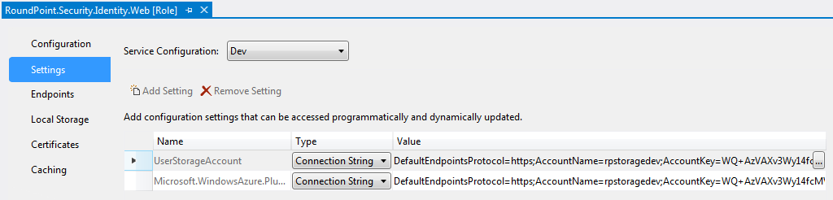
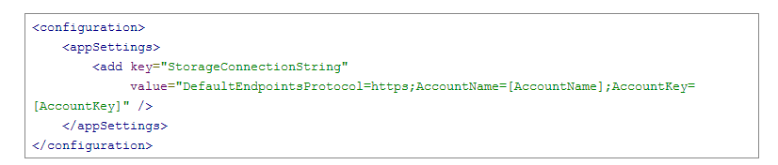
Accessing Table Storage
Storage is accessed through a connection string using the Account Name and Account Key
The connection string is saved in the Service Configuration

Slide 12
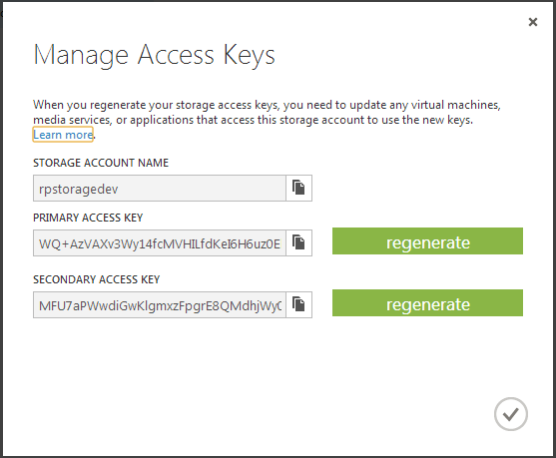
Why are there two access keys?
Two keys allows you to regenerate one key while using the other for added security.
Always use the Primary Account Key

Slide 13

Accessing Table Storage - .NET Libraries
Azure Storage Client
Included with Azure SDK
CloudFx
NuGet Package
Solid Asynchronous Messaging
Developed and used internally at Microsoft
.NET 4.0 - 4.5
.NET 4.0 only (for now)
Invokes Azure Storage Client
async / await compatible
LINQ Support on Table Storage Queries
Resume failed Blob downloads
Avoid using Lokad in your solution. The project is no longer being maintained and is not compatible with newer versions of the Azure SDK

Slide 14
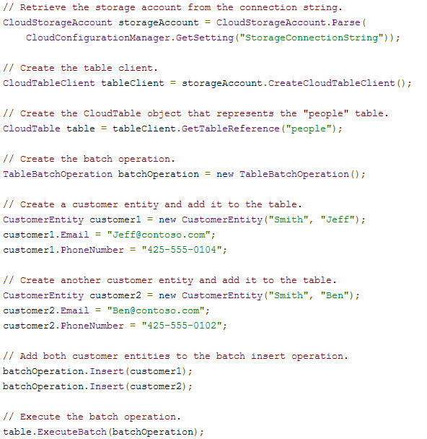
Querying Table Storage v2.0 - Insert
http://www.windowsazure.com/en-us/develop/net/how-to-guides/table-services/

Slide 15
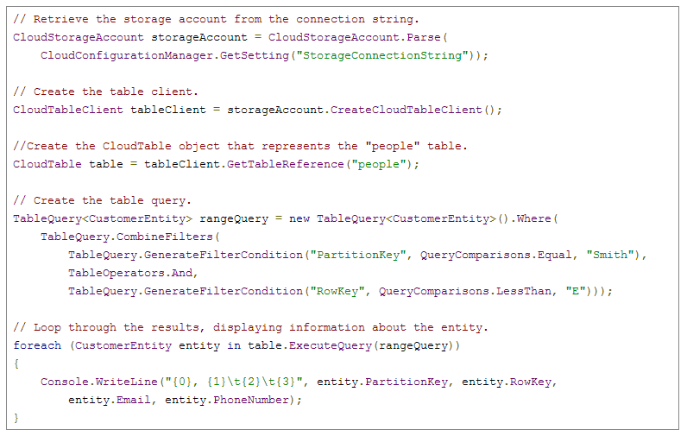
Querying Table Storage v2.0 - Select
Query on PK, RK, and even table properties using the TableQuery class
http://www.windowsazure.com/en-us/develop/net/how-to-guides/table-services/

Slide 16
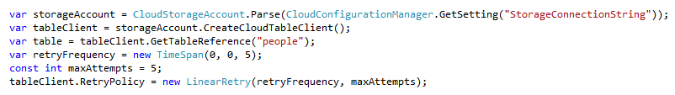
Fault Handling - Retry Policy
Programmatically customize retry behavior when an exception occurs in your application
NoRetry
Disable Retry functionality
Retry
Specified number of retries
Specified time interval
RetryExponential
Specified number of retries
Exponentially increasing back-off
Randomized with +/- 20% delta
MSDN: http://msdn.microsoft.com/en-us/library/microsoft.windowsazure.storageclient.retrypolicies_members.aspx

Slide 17
Table Limitations
Rows are limited to 1mb
Properties are limited to 64kb
Up to 255 properties (including PK, RK, Timestamp)
Only 1000 records can be retrieved per call
Up to 20,000 per second can be processed
http://msdn.microsoft.com/en-us/library/windowsazure/dd179338.aspx
http://blogs.msdn.com/b/windowsazure/archive/2012/11/02/windows-azure-s-flat-network-storage-and-2012-scalability-targets.aspx

Slide 18
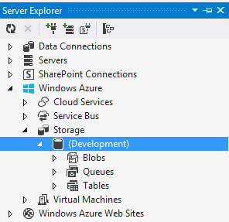
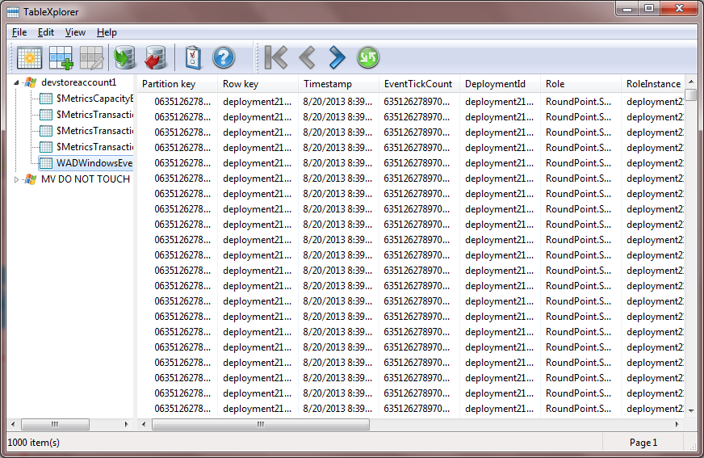
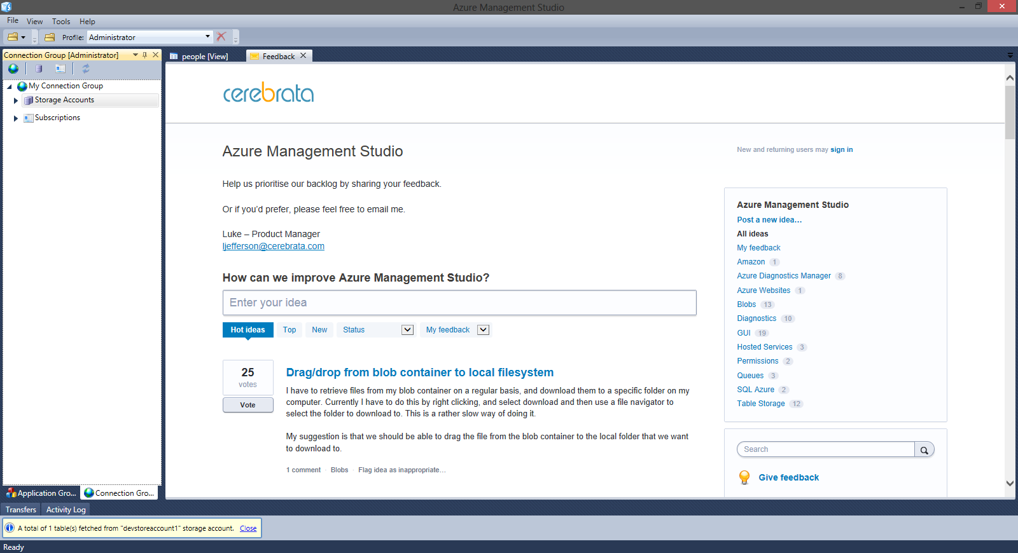
Tools
Visual Studio
Query/Browse Storage accounts
TableXplorer
Export/Import data (use locally only)
Azure Management Studio
Best utility for managing Azure storage accounts
$195/license

Slide 19
Windows Azure Data Management
Azure Tables
Azure Blobs
Azure Queues
Notes:
Slide Objectives:
Highlight the four areas in which this session will focus on.
VALUE PROP:
Speaking Points:
This session will cover the following topics:
SQL Server in a Virtual Machine
Windows Azure SQL Database
Azure Table Storage
Azure Blob Storage
Notes:

Slide 20
Windows Azure Blob Storage
Unstructured Data Storage
Managed service
Hundreds of gigabytes per blob in size
100TB per storage account
REST API
Geo-replication for disaster recovery
Notes:
Slide Objectives
Define the blob storage service and the benefits of the service
VALUE PROP
Enable customers to easily migrate, maintain, and monitor their existing SQL Server applications to Windows Azure VM role, and run them with competitive reliability, performance, and TCO characteristics.
Speaking Points:
Blobs are the simplest way to store large amounts of unstructured text or binary data such as video, audio and images. Blobs are an ISO 27001 certified managed service can auto-scale to meet massive volume of up to 100 terabytes and throughput and accessible from virtually anywhere via REST and managed API’s.
Notes
Using the REST API for the Blob service, developers can create a hierarchical namespace similar to a file system. Blob names may encode a hierarchy by using a configurable path separator. For example, the blob names MyGroup/MyBlob1 and MyGroup/MyBlob2 imply a virtual level of organization for blobs. The enumeration operation for blobs supports traversing the virtual hierarchy in a manner similar to that of a file system, so that you can return a set of blobs that are organized beneath a group. For example, you can enumerate all blobs organized under MyGroup/.

Slide 21
Blob Storage Concepts
http://<account>.blob.core.windows.net/<container>/<blobname>
Account
Container
Blob
PIC01.JPG
images
PIC02.JPG
contoso
videos
VID1.AVI
* Blob names must be limited to 256 characters
Notes:
Slide Objectives
Understand the hierarchy of Blob storage
VALUE PROP
Enable customers to easily migrate, maintain, and monitor their existing SQL Server applications to Windows Azure VM role, and run them with competitive reliability, performance, and TCO characteristics.
Speaker Notes
The Blob service provides storage for entities, such as binary files and text files.
The REST API for the Blob service exposes two resources:
Containers
Blobs.
A container is a set of blobs; every blob must belong to a container.
The Blob service defines two types of blobs:
Block blobs, which are optimized for streaming.
Page blobs, which are optimized for random read/write operations and which provide the ability to write to a range of bytes in a blob.
Blobs can be read by calling the Get Blob operation. A client may read the entire blob, or an arbitrary range of bytes.
Block blobs less than or equal to 64 MB in size can be uploaded by calling the Put Blob operation.
Block blobs larger than 64 MB must be uploaded as a set of blocks, each of which must be less than or equal to 4 MB in size.
Page blobs are created and initialized with a maximum size with a call to Put Blob.
To write content to a page blob, you call the Put Page operation. The maximum size currently supported for a page blob is 1 TB.
Notes
http://msdn.microsoft.com/en-us/library/dd573356.aspx
Using the REST API for the Blob service, developers can create a hierarchical namespace similar to a file system. Blob names may encode a hierarchy by using a configurable path separator. For example, the blob names MyGroup/MyBlob1 and MyGroup/MyBlob2 imply a virtual level of organization for blobs. The enumeration operation for blobs supports traversing the virtual hierarchy in a manner similar to that of a file system, so that you can return a set of blobs that are organized beneath a group. For example, you can enumerate all blobs organized under MyGroup/.

Slide 22

Blob Details
Main Web Service Operations
PutBlob
GetBlob
DeleteBlob
CopyBlob
SnapshotBlob
LeaseBlob
Notes:
Slide Objectives
Understand the hierarchy of Blob storage
Speaker Notes
Put Blob - Creates a new blob or replaces an existing blob within a container.
Get Blob - Reads or downloads a blob from the system, including its metadata and properties.
Delete Blob - Deletes a blob
Copy Blob - Copies a source blob to a destination blob within the same storage account.
SnapShot Blob - The Snapshot Blob operation creates a read-only snapshot of a blob.
Lease Blob - Establishes an exclusive one-minute write lock on a blob. To write to a locked blob, a client must provide a lease ID.
Using the REST API for the Blob service, developers can create a hierarchical namespace similar to a file system.
Blob names may encode a hierarchy by using a configurable path separator. For example, the blob names MyGroup/MyBlob1 and MyGroup/MyBlob2 imply a virtual level of organization for blobs.
The enumeration operation for blobs supports traversing the virtual hierarchy in a manner similar to that of a file system, so that you can return a set of blobs that are organized beneath a group.
For example, you can enumerate all blobs organized under MyGroup/.
Notes
The Blob service provides storage for entities, such as binary files and text files. The REST API for the Blob service exposes two resources: containers and blobs. A container is a set of blobs; every blob must belong to a container. The Blob service defines two types of blobs:
Block blobs, which are optimized for streaming. This type of blob is the only blob type available with versions prior to 2009-09-19.
Page blobs, which are optimized for random read/write operations and which provide the ability to write to a range of bytes in a blob. Page blobs are available only with version 2009-09-19.
Containers and blobs support user-defined metadata in the form of name-value pairs specified as headers on a request operation.
Using the REST API for the Blob service, developers can create a hierarchical namespace similar to a file system. Blob names may encode a hierarchy by using a configurable path separator. For example, the blob names MyGroup/MyBlob1 and MyGroup/MyBlob2 imply a virtual level of organization for blobs. The enumeration operation for blobs supports traversing the virtual hierarchy in a manner similar to that of a file system, so that you can return a set of blobs that are organized beneath a group. For example, you can enumerate all blobs organized under MyGroup/.
A block blob may be created in one of two ways. Block blobs less than or equal to 64 MB in size can be uploaded by calling the Put Blob operation. Block blobs larger than 64 MB must be uploaded as a set of blocks, each of which must be less than or equal to 4 MB in size. A set of successfully uploaded blocks can be assembled in a specified order into a single contiguous blob by calling Put Block List. The maximum size currently supported for a block blob is 200 GB.
Page blobs are created and initialized with a maximum size with a call to Put Blob. To write content to a page blob, you call the Put Page operation. The maximum size currently supported for a page blob is 1 TB.
Blobs support conditional update operations that may be useful for concurrency control and efficient uploading.
Blobs can be read by calling the Get Blob operation. A client may read the entire blob, or an arbitrary range of bytes.
For the Blob service API reference, see Blob Service API.

Slide 23
Blob Details
Associate Metadata with Blob
Standard HTTP metadata/headers (Cache-Control, Content-Encoding, Content-Type, etc)
Metadata is <name, value> pairs, up to 8KB per blob
Either as part of PutBlob or independently
Notes:
Slide Objectives
Understand the hierarchy of Blob storage
Speaker Notes
Put Blob - Creates a new blob or replaces an existing blob within a container.
Get Blob - Reads or downloads a blob from the system, including its metadata and properties.
Delete Blob - Deletes a blob
Copy Blob - Copies a source blob to a destination blob within the same storage account.
SnapShot Blob - The Snapshot Blob operation creates a read-only snapshot of a blob.
Lease Blob - Establishes an exclusive one-minute write lock on a blob. To write to a locked blob, a client must provide a lease ID.
Using the REST API for the Blob service, developers can create a hierarchical namespace similar to a file system.
Blob names may encode a hierarchy by using a configurable path separator. For example, the blob names MyGroup/MyBlob1 and MyGroup/MyBlob2 imply a virtual level of organization for blobs.
The enumeration operation for blobs supports traversing the virtual hierarchy in a manner similar to that of a file system, so that you can return a set of blobs that are organized beneath a group.
For example, you can enumerate all blobs organized under MyGroup/.
Notes
The Blob service provides storage for entities, such as binary files and text files. The REST API for the Blob service exposes two resources: containers and blobs. A container is a set of blobs; every blob must belong to a container. The Blob service defines two types of blobs:
Block blobs, which are optimized for streaming. This type of blob is the only blob type available with versions prior to 2009-09-19.
Page blobs, which are optimized for random read/write operations and which provide the ability to write to a range of bytes in a blob. Page blobs are available only with version 2009-09-19.
Containers and blobs support user-defined metadata in the form of name-value pairs specified as headers on a request operation.
Using the REST API for the Blob service, developers can create a hierarchical namespace similar to a file system. Blob names may encode a hierarchy by using a configurable path separator. For example, the blob names MyGroup/MyBlob1 and MyGroup/MyBlob2 imply a virtual level of organization for blobs. The enumeration operation for blobs supports traversing the virtual hierarchy in a manner similar to that of a file system, so that you can return a set of blobs that are organized beneath a group. For example, you can enumerate all blobs organized under MyGroup/.
A block blob may be created in one of two ways. Block blobs less than or equal to 64 MB in size can be uploaded by calling the Put Blob operation. Block blobs larger than 64 MB must be uploaded as a set of blocks, each of which must be less than or equal to 4 MB in size. A set of successfully uploaded blocks can be assembled in a specified order into a single contiguous blob by calling Put Block List. The maximum size currently supported for a block blob is 200 GB.
Page blobs are created and initialized with a maximum size with a call to Put Blob. To write content to a page blob, you call the Put Page operation. The maximum size currently supported for a page blob is 1 TB.
Blobs support conditional update operations that may be useful for concurrency control and efficient uploading.
Blobs can be read by calling the Get Blob operation. A client may read the entire blob, or an arbitrary range of bytes.
For the Blob service API reference, see Blob Service API.

Slide 24
Blob Details
Blobs are always accessed by name
Can include ‘/‘ or other delimeter in name e.g. /<container>/myblobs/blob.jpg
Notes:
Slide Objectives
Understand the hierarchy of Blob storage
Speaker Notes
Put Blob - Creates a new blob or replaces an existing blob within a container.
Get Blob - Reads or downloads a blob from the system, including its metadata and properties.
Delete Blob - Deletes a blob
Copy Blob - Copies a source blob to a destination blob within the same storage account.
SnapShot Blob - The Snapshot Blob operation creates a read-only snapshot of a blob.
Lease Blob - Establishes an exclusive one-minute write lock on a blob. To write to a locked blob, a client must provide a lease ID.
Using the REST API for the Blob service, developers can create a hierarchical namespace similar to a file system.
Blob names may encode a hierarchy by using a configurable path separator. For example, the blob names MyGroup/MyBlob1 and MyGroup/MyBlob2 imply a virtual level of organization for blobs.
The enumeration operation for blobs supports traversing the virtual hierarchy in a manner similar to that of a file system, so that you can return a set of blobs that are organized beneath a group.
For example, you can enumerate all blobs organized under MyGroup/.
Notes
The Blob service provides storage for entities, such as binary files and text files. The REST API for the Blob service exposes two resources: containers and blobs. A container is a set of blobs; every blob must belong to a container. The Blob service defines two types of blobs:
Block blobs, which are optimized for streaming. This type of blob is the only blob type available with versions prior to 2009-09-19.
Page blobs, which are optimized for random read/write operations and which provide the ability to write to a range of bytes in a blob. Page blobs are available only with version 2009-09-19.
Containers and blobs support user-defined metadata in the form of name-value pairs specified as headers on a request operation.
Using the REST API for the Blob service, developers can create a hierarchical namespace similar to a file system. Blob names may encode a hierarchy by using a configurable path separator. For example, the blob names MyGroup/MyBlob1 and MyGroup/MyBlob2 imply a virtual level of organization for blobs. The enumeration operation for blobs supports traversing the virtual hierarchy in a manner similar to that of a file system, so that you can return a set of blobs that are organized beneath a group. For example, you can enumerate all blobs organized under MyGroup/.
A block blob may be created in one of two ways. Block blobs less than or equal to 64 MB in size can be uploaded by calling the Put Blob operation. Block blobs larger than 64 MB must be uploaded as a set of blocks, each of which must be less than or equal to 4 MB in size. A set of successfully uploaded blocks can be assembled in a specified order into a single contiguous blob by calling Put Block List. The maximum size currently supported for a block blob is 200 GB.
Page blobs are created and initialized with a maximum size with a call to Put Blob. To write content to a page blob, you call the Put Page operation. The maximum size currently supported for a page blob is 1 TB.
Blobs support conditional update operations that may be useful for concurrency control and efficient uploading.
Blobs can be read by calling the Get Blob operation. A client may read the entire blob, or an arbitrary range of bytes.
For the Blob service API reference, see Blob Service API.

Slide 25
Enumerating Blobs
GET Blob operation takes parameters
Prefix
Delimiter
Include= (snapshots, metadata etc…)
http://adventureworks.blob.core.windows.net/
Products/Bikes/SuperDuperCycle.jpg
Products/Bikes/FastBike.jpg
Products/Canoes/Whitewater.jpg
Products/Canoes/Flatwater.jpg
Products/Canoes/Hybrid.jpg
Products/Tents/PalaceTent.jpg
Products/Tents/ShedTent.jpg
GET http://.../products?comp=list&prefix=Tents&delimiter=/
<Blob>Tents/PalaceTent.wmv</Blob>
<Blob>Tents/ShedTent.wmv</Blob>
Notes:
Slide Objective
Understand basics of listing blobs in a container
Speaker Notes
The List Blobs operation enumerates the list of blobs under the specified container.
Can include uncommitted Blobs- see discussion on Blocks and Block Lists
Can include snapshots
Notes
http://msdn.microsoft.com/en-us/library/dd135734.aspx

Slide 26
Pagination
Large lists of Blobs can be paginated
Either set maxresults or;
Exceed default value for maxresults (5000)
http://.../products?comp=list&prefix=Canoes&maxresults=2
<Blob>Canoes/Whitewater.jpg</Blob>
<Blob>Canoes/Flatwater.jpg</Blob>
<NextMarker>MarkerValue</NextMarker>
http://.../products?comp=list&prefix=Canoes&maxresults=2 &marker=MarkerValue
<Blob>Canoes/Hybrid.jpg</Blob>
Notes:
Slide Objective
Understand pagination when listing blobs
Speaker Notes
Reponses over multiple pages return a marker value
This marker is sent to get subsequent page
Notes
http://msdn.microsoft.com/en-us/library/dd135734.aspx

Slide 27
Windows Azure Data Management
Azure Tables
Azure Blobs
Azure Queues
Notes:
Slide Objectives:
Highlight the four areas in which this session will focus on.
VALUE PROP:
Speaking Points:
This session will cover the following topics:
SQL Server in a Virtual Machine
Windows Azure SQL Database
Azure Table Storage
Azure Blob Storage
Notes:

Slide 28
Windows Azure Queue Storage
Azure Queues
Reliable Messaging Between Services
Short item lease sizes
Fault tolerant (with worker roles)
5GB per queue
REST API
Short item lifetime (< 7 days)
Notes:
Slide Objectives
Define the blob storage service and the benefits of the service
VALUE PROP
Enable customers to easily migrate, maintain, and monitor their existing SQL Server applications to Windows Azure VM role, and run them with competitive reliability, performance, and TCO characteristics.
Speaking Points:
Blobs are the simplest way to store large amounts of unstructured text or binary data such as video, audio and images. Blobs are an ISO 27001 certified managed service can auto-scale to meet massive volume of up to 100 terabytes and throughput and accessible from virtually anywhere via REST and managed API’s.
Notes
Using the REST API for the Blob service, developers can create a hierarchical namespace similar to a file system. Blob names may encode a hierarchy by using a configurable path separator. For example, the blob names MyGroup/MyBlob1 and MyGroup/MyBlob2 imply a virtual level of organization for blobs. The enumeration operation for blobs supports traversing the virtual hierarchy in a manner similar to that of a file system, so that you can return a set of blobs that are organized beneath a group. For example, you can enumerate all blobs organized under MyGroup/.

Slide 29
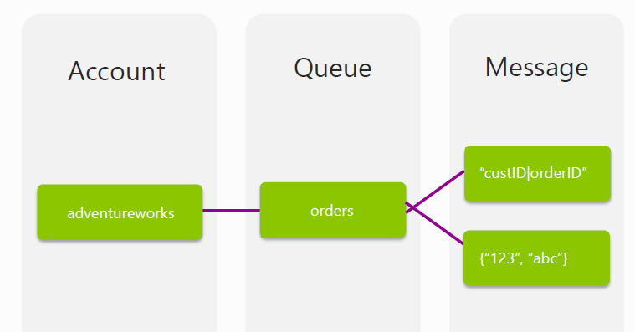
Queue Storage Concepts

Slide 30
Loosely Coupled Workflow with Queues
Worker Role
Web Role
Worker Role
Queue
Web Role
Worker Role
Worker Role

Slide 31
Queue Operations
PutMessage – Adds message to the queue
GetMessages – Reads messages from the queue, makes messages invisible to other consumers
PeekMessages – Reads one or more messages from the front of the queue without hiding them
DeleteMessage – Permanently deletes messages
UpdateMessage – Updates content, visibility, or timeout

Slide 32
Queue Naming Rules
Valid DNS name
Between 3 and 63 characters
Letters, numbers, and dash (-) only
All lowercase
Must start with a letter or number

Slide 33
Storage Account Best Practices
Protect production storage keys as they are the keys to the kingdom
Create a separate storage account for diagnostics and logging so those account keys can be shared with prod support developers
Create additional storage accounts for high traffic queues or blobs to ensure maximum performance

Slide 34
Questions?
Notes:
Speaking Points:
The final thing I’ll mention about Windows Azure, before we dive into the tour of services is the approach we’re taking with paying for services.
This maybe different for many of you who are familiar with hosting providers and on-premises systems.
With Windows Azure you pay only for what you use.
There are no upfront cost
There is no need to buy any up front server licenses, that’s just included in the price
Likewise if you use a SQL database, through our SQL Database feature in Windows Azure, you don’t have to buy a SQL Server license, that’s also included in the price.
For compute services such as Virtual Machines and Web Sites you only pay by the hour.
This gives you the flexibility to run your applications very cost effectively.
You can scale up and scale down your solutions or even turn them on and off as necessary.
This also opens up a ton of possibilities in terms of the new types of apps you can build

